Slide 1
Automated DC Deployment at the BMW Group
Raimund Andrée, Microsoft
Jan-Hendrik Peters, Microsoft

Slide 2
Agenda
Introduction
Using DSC at the BMW group
The theory
The obstacles
The solutions
The takeaways
Rapid and automated lab deployment

Slide 3
Introduction

Slide 4
Desired State Configuration
Infrastructure as code™
MOF-based open standard
Ideal for DevOps
Idempotent
Applied automatically – same results always
Unwanted changes are reverted
Reportable
Compliance status across large infrastructure
Shared Code
Resources on GitHub
Quality checks and tests enforced

Slide 5

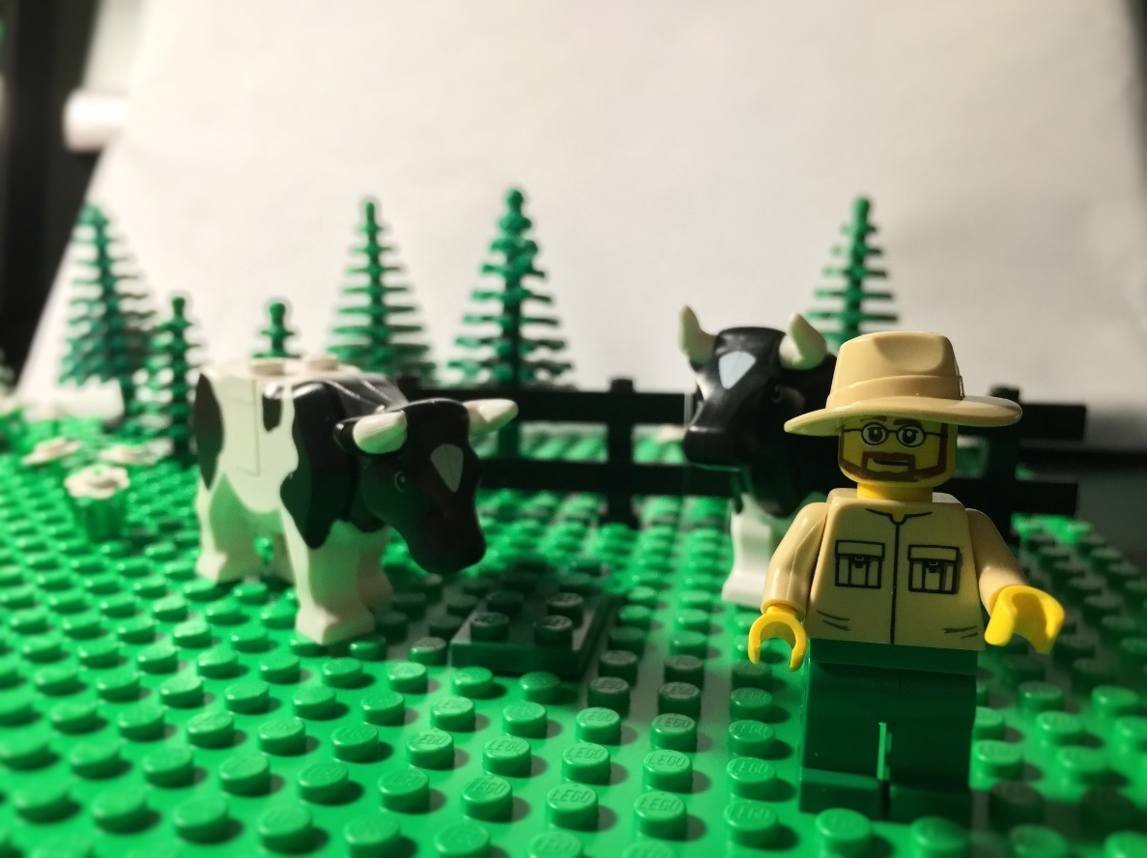
IaC Best Practices
Treat your infrastructure like “cattle”,
…not “pets”

Slide 6
Desired State Configuration
Push or pull mode
Actively push a configuration
Let clients pull configuration data
Configuration enacted locally on each node
Configuration drift is prevented
Changes are reverted

Slide 7
Configuration IISWebsite
{
Node Server1
{
WindowsFeature IIS
{
Ensure = "Present"
Name = "Web-Server"
}
WindowsFeature ASP
{
Ensure = "Present"
Name = "Web-Asp-Net45"
}
}
}
Notes:
The typical example
Many similar examples
Tackle only basic issues
What about the AD?

Slide 8
Case study BMW Group

Slide 9
BMW Group like almost any enterprise
Domain controllers are created manually
A long list of instructions needs to be followed
Several historically grown scripts need to be executed
Configuration drift on domain controllers
Over time
DCs distributed throughout the world
Missing compliance reporting
Like many other companies little to no asset compliance reporting

Slide 10
The theory
Replace the setup and installation manual with DSC configurations
Cover as much as possible, exclude legacy technology like WINS
Leverage publicly available code
DSC resources on GitHub are covering most standard tasks
Extend the DSC resources on GitHub instead of writing closed solutions
Solving 3 issues with one approach
Automated deployment (IaC)
Configuration Drift
Compliance Reporting

Slide 11
Moving the theory into reality – the obstacles
Almost every domain controller has a different config
Writing DSC configs by hand is not an option
Contradicts the common assumption of DSC
Getting a development environment ready
At least 15 machines with AD, SQL, PKI, Pull Server
For load testing 8 + ~100 (very important task!)
DSC is not a ready-to-use solution (good and bad)
Most of the requirements could not be handled with DSC OOB

Slide 12
Moving the theory into reality – the obstacles
“Uncommon” resources not actively developed
xStorage: Partition resize not possible
xActiveDirectory: DCPromo with IFM file not possible
xScheduledTask: Several shortcomings
…
Adoption of DSC still fairly low
Issues without troubleshooting info occur from time to time
Not enough documentation on e.g. scalable node status reporting

Slide 13
Moving the theory into reality – the solution
Almost every domain controller has a different config
Moving configuration data into easily manageable files (txt, csv, xml, SQL)
Building a solution to translate the configuration data into DSC configs (hash tables, PSObjects)
Automating the development environment deployment
AutomatedLab for rapid, scalable and extensible development environment deployments
There is a dedicated session on this topic
DSC is not a ready-to-use solution (good and bad)
Build your framework around DSC or use ours

Slide 14
Demo
Moving the theory into reality – Demo
Raimund: Assembling ConfigurationData
Jan: Authoring the configuration
Raimund: Setting up the LCM with partial configs
Notes:
-

Slide 15
Demo
How to define a lab matching the your productive environment
Framework: AutomatedLab
For BMW Group, the test scenario is: 3 Domains with 1 domain controller each
1 CA, 1 SQL Sever 2016, 1 Pull Server
8 (or n) unconfigured VMs to test the domain controller setup
Notes:
-

Slide 16
Node Status Reporting
There is no official best practice for now
EDB (default database)
Locked
Hard to interact
MDB
max file size of 2GB
Using MDB as a proxy to SQL 2016
“Very easy” to retrieve data
SQL 2016 native JSON support
PowerBI

Slide 17
Demo
Using PowerBI to visualize the overall DSC state

Slide 18
Takeaway / Summary
DSC can deploy a highly complex domain setup
Solution with a high level of maturity
The community resources are required
DSC is a framework, not a inflexible solution
Use SQL Server 2016 (native JSON support incl. JSON indexes) for the database backend
Install your own lab: https://aka.ms/automatedlab

Slide 19
Next Steps...
Now: 15 min break
Grab a coffee
Stay here to enjoy next presentation
Change track and switch to another room
Ask me questions or meet me in a breakout session room afterwards

Slide 20
Questions?

Slide 21
About_Author
PS C:\Users\raandree> Get-Introduction
Name : Raimund Andrée
Born : 1978-07-31
Profession : Premier Field Engineer @ Microsoft Germany
Years in field : 22
Technologies : {PowerShell, DevOps, DSC, Active Directory}
Hobbies : {Traveling to so called high risk countries, Coding, Hiking}

Slide 22
About_Author
PS C:\Users\japete> Get-Introduction
Name : Jan-Hendrik Peters
Born : 1987-01-24
Profession : Premier Field Engineer @ Microsoft Germany
Years in field : 7
Technologies : {PowerShell, DevOps, DSC, Active Directory}
Hobbies : {Travelling, Brewing, Coding, Hiking}

